Slide 1
HTML &HTML 5 Podstawy

Slide 2
HTML, HTTP
HTML – hipertekstowy język znaczników
HTTP - protokół przesyłania dokumentów hipertekstowych
URI - standardem internetowym umożliwiającym identyfikację zasobów
URL - ujednolicony format adresowania zasobów

Slide 3
Struktura dokumentu HTML
<!DOCTYPE html PUBLIC "-//W3C//DTD XHTML 1.0 Transitional//EN" "http://www.w3.org/TR/xhtml1/DTD/xhtml1-transitional.dtd"> - <html xmlns="http://www.w3.org/1999/xhtml"> <head> nagłówek strony, meta dane javascripty i css’y w miarę możliwości </head> <body> treść strony, obiekty, filmy, audio </body> </html>

Slide 4
Struktura dokumentu w HTML5
<!DOCTYPE HTML>
<html>
<head>
<meta http-equiv="Content-Type" content="text/html; charset=UTF-8" />
<title>Your Website</title>
</head>
<body>
<header>
<nav>
<ul>
<li>Your menu</li>
</ul>
</nav>
</header>

Slide 5
<section>
<article>
<header>
<h2>Article title</h2>
<p>Posted on <time datetime="2009-09-04T16:31:24+02:00">September 4th 2009</time> by <a href="#">Writer</a> - <a href="#comments">6 comments</a></p>
</header>
<p>Pellentesque habitant morbi tristique senectus et netus et malesuada fames ac turpis egestas.</p>
</article>
<article>
<header>
<h2>Article title</h2>
<p>Posted on <time datetime="2009-09-04T16:31:24+02:00">September 4th 2009</time> by <a href="#">Writer</a> - <a href="#comments">6 comments</a></p>
</header>
<p>Pellentesque habitant morbi tristique senectus et netus et malesuada fames ac turpis egestas.</p>
</article>
</section>

Slide 6
<aside>
<h2>About section</h2>
<p>Donec eu libero sit amet quam egestas semper. Aenean ultricies mi vitae est. Mauris placerat eleifend leo.</p>
</aside>
<footer>
<p>Copyright 2009 Your name</p>
</footer>
</body>
</html>

Slide 7
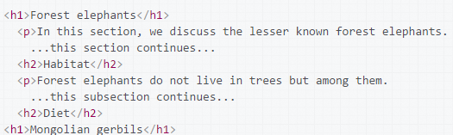
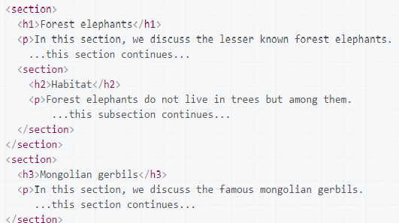
Różnice między HTML4 a HTML 5 w strukturze
https://developer.mozilla.org/pl/docs/Web/Guide/HTML/Sekcje_oraz_konspekt_dokumentu_HTML5
HTML4 | HTML5

Slide 8
Podstawowe znaczniki
http://www.w3schools.com/tags/

Slide 9
Znaczniki wideo
Attribute | Value | Description
autoplay | autoplay | Specifies that the video will start playing as soon as it is ready
controls | controls | Specifies that video controls should be displayed (such as a play/pause button etc).
height | pixels | Sets the height of the video player
loop | loop | Specifies that the video will start over again, every time it is finished
muted | muted | Specifies that the audio output of the video should be muted
poster | URL | Specifies an image to be shown while the video is downloading, or until the user hits the play button
preload | auto metadata none | Specifies if and how the author thinks the video should be loaded when the page loads
src | URL | Specifies the URL of the video file
width | pixels | Sets the width of the video player

Slide 10
Znaczniki audio
Attribute | Value | Description
autoplay | autoplay | Specifies that the audio will start playing as soon as it is ready
controls | controls | Specifies that audio controls should be displayed (such as a play/pause button etc)
loop | loop | Specifies that the audio will start over again, every time it is finished
muted | muted | Specifies that the audio output should be muted
preload | auto metadata none | Specifies if and how the author thinks the audio should be loaded when the page loads
src | URL | Specifies the URL of the audio file

Slide 11
Typy inputów HTML 4
button | Defines a clickable button (mostly used with a JavaScript to activate a script)
checkbox | Defines a checkbox
file | Defines a file-select field and a "Browse..." button (for file uploads)
hidden | Defines a hidden input field
image | Defines an image as the submit button
password | Defines a password field (characters are masked)
radio | Defines a radio buton
reset | Defines a reset button (resets all form values to default values)
submit | Defines a submit buton
text | Default. Defines a single-line text field (default width is 20 characters)

Slide 12
Typy inputów HTML 5
color | Defines a color picker
date | Defines a date control (year, month and day (no time))
datetime | The input type datetime has been removed from the HTML standard. Use datetime-local instead.
datetime-local | Defines a date and time control (year, month, day, hour, minute, second, and fraction of a second (no time zone)
email | Defines a field for an e-mail address
month | Defines a month and year control (no time zone)
number | Defines a field for entering a number
range | Defines a control for entering a number whose exact value is not important (like a slider control)
search | Defines a text field for entering a search string
tel | Defines a field for entering a telephone number
time | Defines a control for entering a time (no time zone)
url | Defines a field for entering a URL
week | Defines a week and year control (no time zone)

Slide 13
Atrybuty inputów
http://www.w3schools.com/tags/tag_input.asp

Slide 14
Canvas
http://www.w3schools.com/tags/ref_canvas.asp

